Slide 1

A study on sentiment classification of news headlines
Joao Tiago Viegas
R00157699
Higher Diploma
in Science
in
Data Science and Analytics
December 2018
using deep learning

Slide 2
Intro
motivation and dataset
methodology
findings
conclusion
A study on sentiment classification of news headlines using deep learning | R00157699 | Higher Diploma in Science in Data Science and Analytics | 2018

Slide 3
motivation and dataset

Slide 4



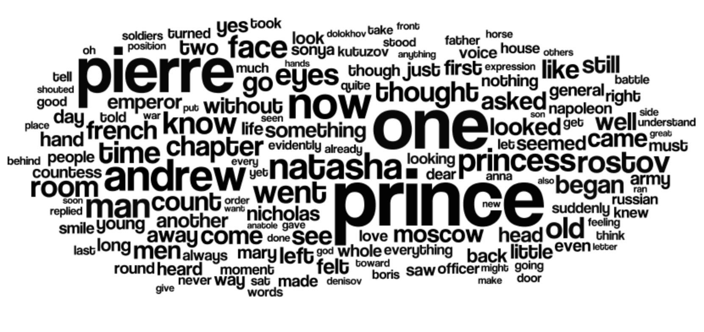
motivation
product feedback
sentiment analysis
fraud detection
automatic translation
recommendation systems
security surveillance
podcast
e-mail
sms
api’s
blog
internet
IoT
social networks
sensor
A study on sentiment classification of news headlines using deep learning | R00157699 | Higher Diploma in Science in Data Science and Analytics | 2018
Notes:
Explosion of data -> still discovering how to leverage it -> machine learning uses this data to find patterns and associations and discover information from it -> it has been used examples -> we will focus in a subset of machine learning tasks sentiment analysis that tries to understand the emotion conveyed in text data

Slide 5
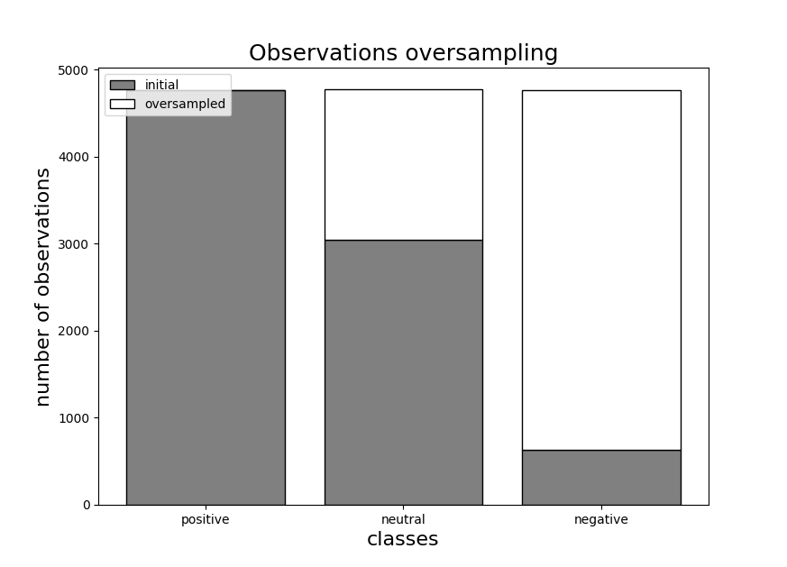

dataset - sentiment analysis
news headlines subset from reuters;
dates range: 08.01 2007 -> 02.10.2018;
9385 observations;
10-fold cross validation sample:
Training set: 8447 observations;
negative: 632, neutral: 3044, positive: 4771;
A study on sentiment classification of news headlines using deep learning | R00157699 | Higher Diploma in Science in Data Science and Analytics | 2018
Notes:
-> subset of the news headlines in reuters website related to a specific company, IBM
-> Dates
-> imbalanced data regarding the classes
-> training method, 10-fold cross validation as an example we took a sample where …
-> so we’ve scaled the observations form all the classes so that all have the same number

Slide 6
methodology

Slide 7
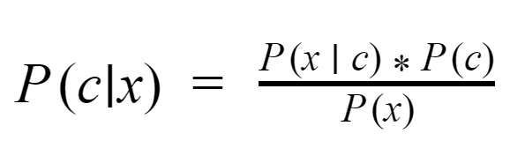
methodology
Baseline - Naïve Bayes
A study on sentiment classification of news headlines using deep learning | R00157699 | Higher Diploma in Science in Data Science and Analytics | 2018
Notes:
Naïve Bayes is one of the most simple machine learning classification algorithms -> naive because assumes probability distributions of its features are independent.
Easy to implement in this case, the factors in the rule are easily computed from a word vector we get the conditional probability of a word being related to aspecific class, and then with the classes probability we can compute the class probability having a specific word

Slide 8
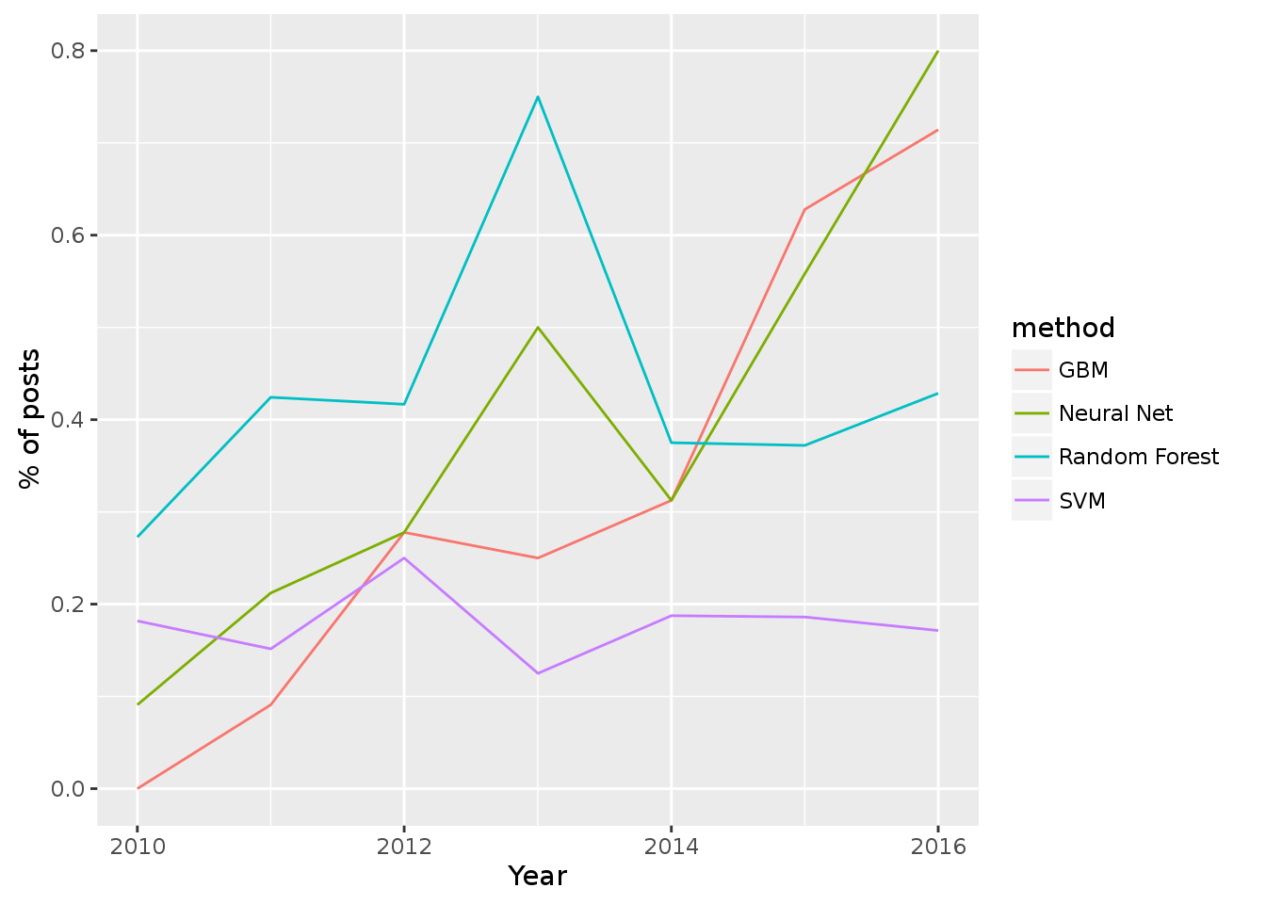
methodology
Deep learning - neural networks?
Neural networks algorithms adoption has been rising:
“...neural networks and gradient boosting machines...so far in 2016, they've been appearing in >70% of winners posts.”
Anthony Goldbloom, Kaggle CEO
A study on sentiment classification of news headlines using deep learning | R00157699 | Higher Diploma in Science in Data Science and Analytics | 2018
Notes:
-> neural networks and Deep Learning have gained substantial momentum in the research community lately
-> Considered effective tool to solve natural language processing tasks, which is the case of our study
-> the data science site Kaggle, it has been the most successful to tackle NLP

Slide 9
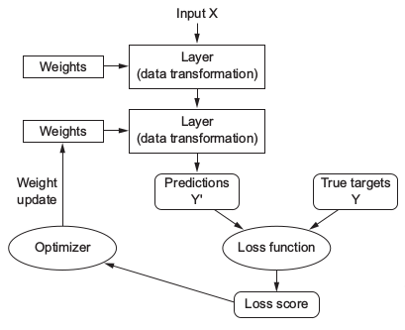
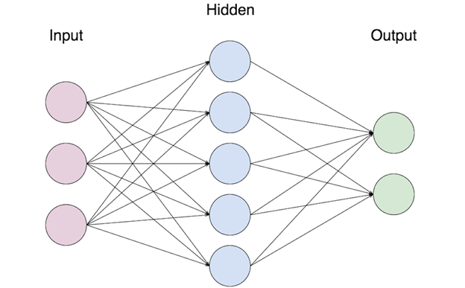
methodology
Deep Learning - Artificial Neural Networks
A study on sentiment classification of news headlines using deep learning | R00157699 | Higher Diploma in Science in Data Science and Analytics | 2018
Notes:
-> Artificial neural networks are the basis of deep learning where deep is associated with the number of hidden layers
-> these layers will are like equations with parameters/weights
-> output is then matched against the classification data resulting in an loss function.
->optimizer, implements back propagation, based on a gradient descent function, clibrates the weights of he equations so that the loss function is minimized at each training iteration and so that we reach an optimal model.
There is a bit more details about he model setup, as for instance the activation functions and there are also different kind of optimizers

Slide 10
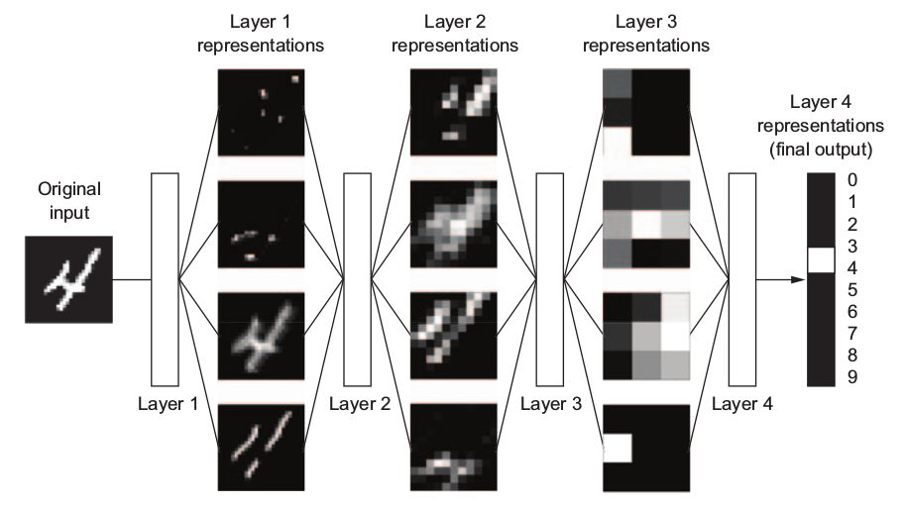
methodology
Deep Learning - Artificial Neural Networks
A study on sentiment classification of news headlines using deep learning | R00157699 | Higher Diploma in Science in Data Science and Analytics | 2018
Notes:
in this case a “4” -> can be translated to a 28*28 matrix where each position has a value, from 0 to 1, also called its activation value, corresponding to its “light effect” -> input for the neural network -> hidden layers are as a set of transformation functions from the input to the output -> is a column matrix | learning -> loss function and optimizer/gradient descent = backpropagation

Slide 11
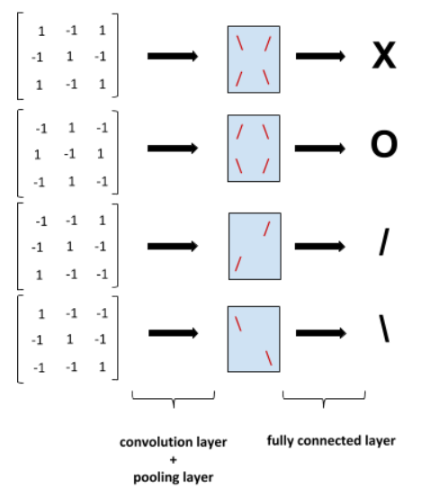
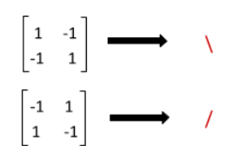
methodology
Deep Learning - Convolutional Neural Networks (CNN)
A study on sentiment classification of news headlines using deep learning | R00157699 | Higher Diploma in Science in Data Science and Analytics | 2018
Notes:
-> The neural network develops knowledge through training in the form of sub-patterns (filters) with lower dimension.
-> convolutional layer and the pooling layer, split the image in pieces and try to match it against those known patterns, called filters
-> input is then interpreted according to this new set of variables, the filters
-> and finally The fully connected layer then uses logic to relate that map with the images and the classification as in the simple neural networks
-> its inner rationale is still the same as explained before, the convolutional and the dense layers do have an activation function, and the network learning is still driven by the loss and the optimizer functions;

Slide 12
findings

Slide 13
findings
neural network models
1 hidden layer
1 hidden layer with Glove pre-trained embeddings
layers | learning
Dense(32, activation='relu') Dense(32, activation='relu') Dense(3, activation='softmax') | optimizer: rmsprop
 | loss: categorical_crossentropy
 | metrics: accuracy, recall, precision, f1_score
layers | learning
Embedding(...) Flatten() Dense(1024, activation='PReLU') Dense(3, activation='softmax') | optimizer: rmsprop
 | loss: categorical_crossentropy
 | metrics: accuracy, recall, precision, f1_score
2 hidden layers with word embeddings
Embedding(...) Conv1D(8, 24, activation='relu') GlobalMaxPooling1D() Dense(3, activation='softmax') | optimizer: rmsprop
 | loss: categorical_crossentropy
 | metrics: accuracy, recall, precision, f1_score
Embedding(...) Flatten() Dense(32, activation='relu') Dense(32, activation='relu') Dense(3, activation='softmax') | optimizer: rmsprop
 | loss: categorical_crossentropy
 | metrics: accuracy, recall, precision, f1_score
One dimensional Convolutional Neural Network
A study on sentiment classification of news headlines using deep learning | R00157699 | Higher Diploma in Science in Data Science and Analytics | 2018
Notes:
-> this is the outcome of experimenting with the network toplogies and parameters
Rmsprop -> one implementation of the gradient descent algorithm that suits neural networks
Categorical_crossentropy -> multiclass
Relu -> (identity function) zeroes the negatives = max(0,z)
Elu -> (identity function) allows for smoothed negative values

Slide 14
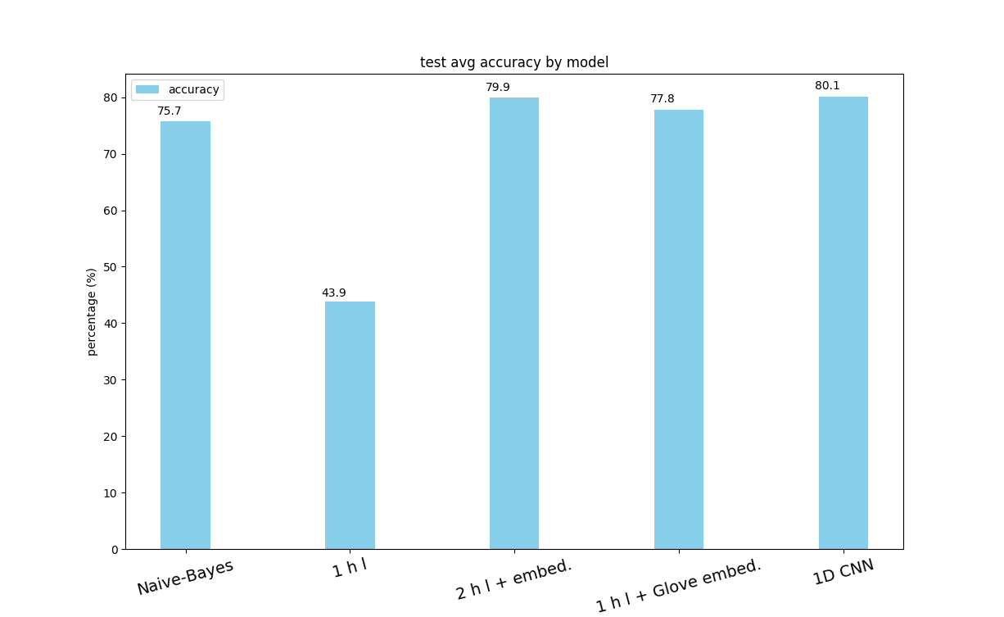
findings
findings - models accuracy
A study on sentiment classification of news headlines using deep learning | R00157699 | Higher Diploma in Science in Data Science and Analytics | 2018

Slide 15
conclusion

Slide 16
conclusion
main findings
Simple 1D CNN achieved better accuracy;
2 layers neural network similar to simple 1D CNN;
GloVe pre-trained word embeddings vector not reflecting domain knowledge;
Naïve Bayes not far away;
future work
include full news article content;
bigger dataset;
further parameter testing;
further topology experimentation;
model | accuracy (avg +/- std)
Naïve Bayes | 75.70% (+/- 1.58%)
1 hidden layer | 43.93% (+/- 5.18%)
2 hidden layers with word embeddings | 79.88% (+/- 1.30%)
1 hidden layer with Glove pre-trained embeddings | 77.78% (+/- 1.90%)
one dimensional CNN | 80.12% (+/- 0.85%)
A study on sentiment classification of news headlines using deep learning | R00157699 | Higher Diploma in Science in Data Science and Analytics | 2018

Slide 17

Thank
You!
code available @ https://github.com/jtviegas/studies/tree/master/cit/deep_learning/code/analysis

